Slide 1
R and Statistics
Matt Owen
mowen@iq.harvard.edu

Slide 2
Prerequisites
Variables and Functions
  Basic R
  How to use variables and Data
  How to use functions
Statistics
  What are statistical distributions
  What are regressions

Slide 3
Outline
R Basics
  Review: Variables, Functions and Data
  New Concepts: Packages and Formulas
Programming Descriptive Statistics
  Numeric: Measuring and Plotting
  Factor: Measuring and Plotting
  Goodness of Fit: QQ-plots
Programming Inferential Statistics

Slide 4
Format for Slides
Regular text will be presented just like this.
Example code will be contained within a dashed box.
# Comments will be grayed-out and preceded by a hash
# Code will be in preceded by “> ”
> sin(1.3)
Results from code example will be in a grayed out box with a dashed border.
[1] 0.9635582

Slide 5
R Basics

Slide 6
Review: Variables, Functions and Data
(R Basics)

Slide 7
Types of Variables in R
Old Concepts (Review)
  Numerics, Strings and Lists
  Functions
  Data
New Concepts
  Packages
  Formulas

Slide 8
Basic Variables
Three basic types of variables
  Numeric (integers and real numbers)
  Character (letters, words and sentences)
  List (a collection of other variables)
Remember:
  How to assign values to a variable
  How to print the values of a variable

Slide 9
Basic Variables
Let’s review basic variables, along with how to assign them.
# Numerical
> Number <- 4
> Numbers <- c(1, 1, 2, 3)
# Character-strings (words and sentences)
> String <- "Hello, World."
# Lists are their own variable but
# can be composed of numerical and character information
> List <- list(number = 4, string = "Some text")
Notes:
Update this slide.

Slide 10
Functions
Functions are composed of two parts:
  A function name, e.g. "median", "plot" or "sin"
  A parameter list
Functions typically return values
  E.g. the "sin" function returns a numeric value
  "plot" and "print" functions typically do not
We won’t be writing new functions today

Slide 11
Functions
Many mathematical functions are already in R.
# Computing the sine of 1.3
> sin(1.3)
# Computing the square-root of 3
> sqrt(3)
# Most statistical functions are available
> numbers <- c(1, 3, 4, 4, 5)
> mean(numbers)
> median(numbers)
# Arithmetic operators can be used along with functions
> 4 + 3
> 2 * numbers
> 2 + sin(1.3)

Slide 12
Functions Continued
Additionally, non-mathematical can be functions.
# Printing a message to the screen
> message("This is a sample message!")
# Printing a message to the screen
> help("median")
Functions are immensely important!
And we will be using them constantly.
Side Note: The "help" function prints information about other functions.

Slide 13
Data
Data sets are referred to as "data frames“
“Data frames” are a type of variable
They are shaped like tables (rows, columns)
Rows represent individual data points
Columns represent variables and specific information about the data point.
A wide variety of functions are available to work with and manipulate "data frames".

Slide 14
Data
We will work with the “ChickWeight” data set
Contains information about Chick Weight
Base on their Diet and Time (Age)
Comes packaged with R
So we use the “data” function
> data(ChickWeight)
The data frame is now loaded, if it seems like nothing happened.
To learn more specific information about the "ChickWeight" data frame, you can use the "help" function.
> help("ChickWeight")

Slide 15
Data (Continued)
A large variety of operations can be performed on data sets.
# Data sets can be summarized
> summary(ChickWeight)
# Plotted using various methods
> boxplot(ChickWeight)
# List the names of the columns of "ChickWeight"
> colnames(ChickWeight)
# Display the number of rows
> nrow(ChickWeight)

Slide 16
Data (Conclusion)
“data” loads data that comes with R
Other ways to load data:
  read.table()
  read.csv()
  load()

Slide 17
Example:
We will now load the "NatHealth2008" data set
This is found on the "S Drive" on the training computers
Because this data is saved as an “rdata" file, we will be using the load command.

Slide 18
Data (A Brief Example)
To use the "load" function, you must specify the location of the data-file.
This file is found in:
"N:/R and Statistics/NatHealth2008.Rdata"
As a result, the command to open the document is as follows:
# Display the number of rows
> load('N://R and Statistics//NatHealth2008.Rdata')

Slide 19
Questions?

Slide 20
New Concepts: Packages and Formula
(R Basics)

Slide 21
Packages
Are collections of data sets and functions.
Add specific mathematical techniques to complement R's built-in features.
Can be downloaded from an interactive R session or directly from CRAN:
http://cran.r-project.org/

Slide 22
Loading Packages
Packages, that are already installed, can be loaded by using the "library" function.
# Load the “MASS" Package
> library(MASS)
# Or load "Zelig", a statistcal package we'll be using later
> library(Zelig)
Most useful or advanced operations with R require the inclusion of a separate statistical package.
For a complete list of available packages on your machine, you can use the "library" function without passing it any parameters.
# List all available R packages
> library()

Slide 23
Packages: A Quick Example
The MASS package contains a data set titled "Animals”.
You can’t load “Animals” until you load the MASS package!
# Display the data frame "Animals"
> data(Animals)
Warning message:
In data(Animals) : data set 'Animals' not found
# Load the "MASS" package
> library(MASS)
# Display the data frame "Animals"
> data(Animals)
> Animals
Your R session should now display the data frame "Animals"

Slide 24
> library(MASS)
Warning message:
package 'MASS' was built under R version 2.13.1
> Animals
body brain
Mountain beaver 1.350 8.1
Cow 465.000 423.0
Grey wolf 36.330 119.5
Goat 27.660 115.0
Guinea pig 1.040 5.5
Dipliodocus 11700.000 50.0
Asian elephant 2547.000 4603.0
Donkey 187.100 419.0
Horse 521.000 655.0
Potar monkey 10.000 115.0
Cat 3.300 25.6
Giraffe 529.000 680.0
Gorilla 207.000 406.0
Human 62.000 1320.0
African elephant 6654.000 5712.0
Triceratops 9400.000 70.0
Rhesus monkey 6.800 179.0
Kangaroo 35.000 56.0
Golden hamster 0.120 1.0
Mouse 0.023 0.4
Rabbit 2.500 12.1
Sheep 55.500 175.0
Jaguar 100.000 157.0
Chimpanzee 52.160 440.0
Rat 0.280 1.9
Brachiosaurus 87000.000 154.5
Mole 0.122 3.0
Pig 192.000 180.0

Slide 25
Packages (Conclusion)
Most statistical techniques are in packages
We will be uses packages extensively
Remember: "libraries()" will list all available packages that can be used.

Slide 26
Reminder: Data Sets
The following script
# Load the "ChickWeight" data frame
> data(ChickWeight)
> colnames(ChickWeight)
Should produce the result:
[1] "weight" "Time" "Chick" "Diet"
The column names are all viable components to a formula relating to the ChickWeight data frame.

Slide 27
Formula Fact Sheet
Formulae relate columns of data sets to one another.
Formulae only make sense in reference to a data frame.
The tilde "~" is used to separate the left and right hand sides of formulae.
The left specifies dependent variables.
The right specifies independent variables.

Slide 28
Example: Formula
Let’s draw a Scatter-Plot using formulae.
Suppose Chick Weights is strictly dependent on time.
# Our dependent
> chick.formula <- weight ~ Time
We can use formulae to define the x and y-axes of a plot, if we
# Draw the scatter plot
> plot(weight ~ Time, data=ChickWeight)
# Or equivalently
> plot(chick.formula, data=ChickWeight)
Thus, we construct the formula:

Slide 29
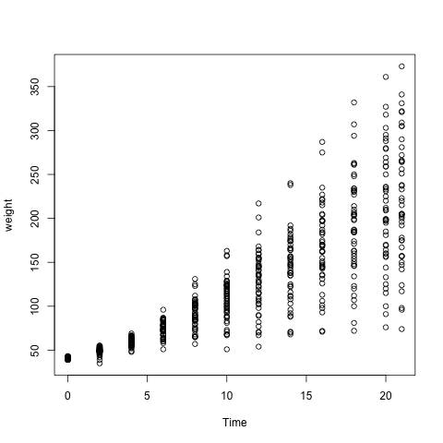
Formula Example (Plot)
displays the growth rate with respect to time (N=50)
growth rate may vary differently between chicks
We can do some simple graphical analysis to see how growth rate varies.

Slide 30
Recap: Formula
The formula (weight ~ time) only specifies that weight and time are related
Does not specify parameters
We use a regression to determine this.
"Fitting" the statistical model determines these unknown parameters

Slide 31
Example: Formula
Chick Weight is clearly not entirely based on Time
Perhaps “Diet” has something to do with weight as well.
The formula weight ~ Time + Diet will not work.
So we must subset the data frame into four distinct ones
Use the “subset” function
# Subset the "ChickWeight" data frame, and plot results
> ChickDiet4 <- subset(ChickWeight, Diet == 4)
> plot(weight ~ Time, ChickDiet4)
Here, subset returns only the data points where diet is 4.
For more information check its help:
# Read the help documentation about the"subset" function
> help("subset")

Slide 32
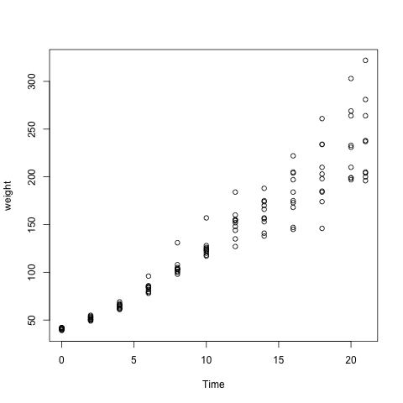
Chick Diet #4 Plot
This plot displays the growth rate with respect to time of only chicks that were on the fourth diet.
Results look more linear
We can use numerical tools in addition to graphical tools

Slide 33
Recap: Formula
"Formulae" (in R) describe the relationship between independent and dependent variables.
To create a formula, you must use the
tilde ("~").
Formulae only make sense in the context of a data set.

Slide 34
Looking Ahead
Will be further exploring the relationship between variables, expressed within a formula, and data sets.
Formulae, data sets and statistical methods will be crucial to everything we do for the remainder of the training session.

Slide 35
Questions?

Slide 36
Exercise: Data and Formulae
Load the “MASS” package
Using “data”, load the “mammals” data set
Create a formula linking brain-mass and body weight
Subset the data frame, so that it only contains animals with body weight less than 10kg
Plot this data using the formula you made

Slide 37
Programming Descriptive Statistics

Slide 38
Outline: Descriptive Statistics
Measuring and Plotting
  Numeric Data
  Factor Data
Statistical Distributions
  Simulating Distributions
  Goodness of Fit (QQ-Plot)

Slide 39
Measuring and Plotting
(Programming Descriptive Statistics)

Slide 40
Programming Descriptive Statistics
We know how to use:
  Formulae and Data Frames
  Functions
  Plots
So we can now work with them all together to do actual useful statistics
Measuring and Plotting statistics is basic
After this, statistical inference

Slide 41
Example: Measuring Numeric Data
# Load this example's data set "survey"
> data(survey)
# Read the documentation, and list the column names
> help("survey")
> colnames(survey)
[1] "Sex" "Wr.Hnd" "NW.Hnd" "W.Hnd" "Fold" "Pulse" "Clap" "Exer"
[9] "Smoke" "Height" "M.I" "Age"
Now, we will:
Compute the mean, median and standard deviation of "Height"
Measure the frequency of smokers in the population
Measure the gender distribution of the population

Slide 42
Example: Measuring Numeric Data
"mean", "median" and "sd" respectively correspond to computing the statistical mean, median and standard deviation of a sample.
# Compute the mean, median and standard deviation of
# students‘ heights
> mean(survey$Height, na.rm=TRUE)
[1] 172.3809
> median(survey$Height, na.rm=TRUE)
[1] 171
> sd(survey$Height, na.rm=TRUE)
[1] 9.847528

Slide 43
Recap: Measuring Numeric Data
"mean", "median" and "sd" work with values not data.frames.
"na.rm=TRUE" removes "Not Available" data before computing these measures.
These functions only work with numerical input. NO FACTORS, etc.
These functions return numerical values.

Slide 44
Example: Plotting Numeric Data
Describing data visually
All of the tools from basic statistics are available
Tools that we will need:
  histogram (hist)
  density plot (density, plot)
  boxplot (boxplot)

Slide 45
Example: Plotting Numeric Data
We will be working with the "survey" data set again.
# Load "MASS", "survey" and store "student.heights"
> library(MASS)
> data(survey)
Let's visualize the frequency of student heights.
# Write labels for our title and y-axis
> myTitle <- "Student Heights"
> myLabel <- "Density of Student Heights"
# "hist" plots histograms
> hist(student$Heights, main = myTitle, ylab = myLabel)

Slide 46
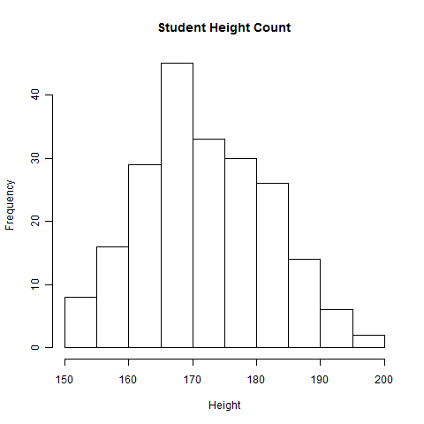
Example: Plotting Numeric Data
Histograms are useful for showing the density of results
We can change the number of breaks by setting the “breaks” parameter
Similar data can be displayed by using the “plot” and “density” functions together

Slide 47
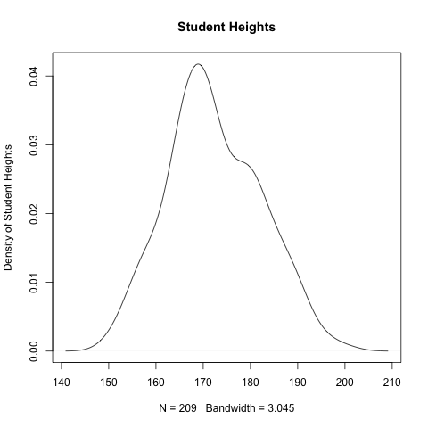
Example: Plotting Numeric Data
# Construct a density-plot (like a histogram but smoother)
> student.density <- density(student.height, na.rm=TRUE)
> plot(student.density, main="Student Heights", ylab=mylabel)
Density-plots are essentially identical to histograms
Require the use of both the “density” and “plot” functions
“na.rm=TRUE” is requires to ensure that missing data is ignored

Slide 48
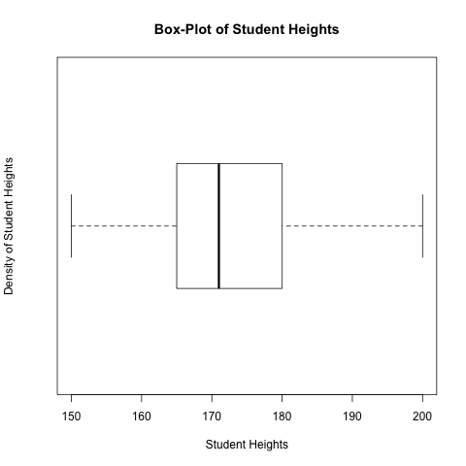
Example: Plotting Numeric Data
# Construct a box-plot, note that you do not use "density"
> boxplot(student.height, horizontal = TRUE)
Box-Plots are useful for displaying quantile information
“horizontal=TRUE” specifies that we want to display our plot horizontally

Slide 49
Recap: Plotting Numeric Data
"hist" plot histograms
"plot" and "density" can be used together to draw density plots
“boxplot" draws box-plots

Slide 50
Review: Factor Data
Categorical and Nominal Data
"levels" returns all the different categories
"table" returns the quantity of each category that is available
"barplots" can display this type of categorical data
Not all plots can!

Slide 51
Example: Describing Factor Data
We will be working with the "survey" data set again.
# Load "MASS", "survey" and store "student.smokes"
> library(MASS)
> data(survey)
To display all the categories of smokers, use the "levels" function
# Display the all categories
> levels(survey$Smoke)
[1] "Heavy" "Never" "Occas" "Regul"
Students' smoking habits can only fall into the above 4 categories.

Slide 52
Example: Describing Factor Data
"table" will numerically display how much of each category is within the sample
# How many students belong to each smoker category?
> table(survey$Smoke)
Heavy Never Occas Regul
11 189 19 17

Slide 53
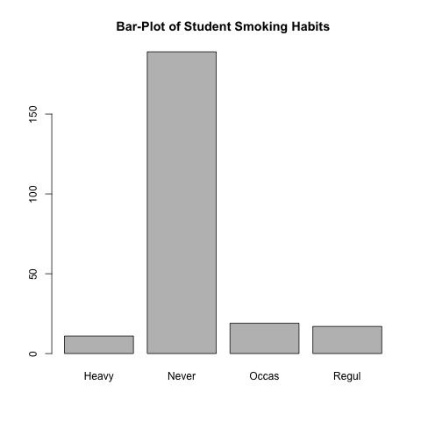
Example 1: Plotting Factor Data
# Simply use the "plot" function. R can figure out what
# is meant by context.
> plot(survey$Smoke)
Bar plots are drawn by the “plot” function

Slide 54
Example 2: Plotting Factor Data
Formulae can also be used with factor data
Typically, this is used to produce bar plots of numeric data dependent upon factor data

Slide 55
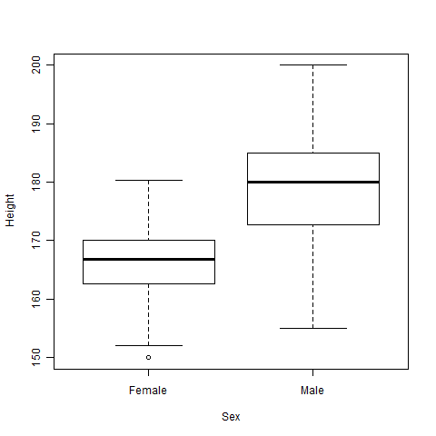
Example 2: Plotting Factor Data
# Simply use the "plot" function. R can figure out what
# is meant by context.
> plot(Height ~ Sex, data=survey)
Two bar-plots are drawn side by side (one for each factor-level)
Stacked barplots can be generated by have factor data as the outcome variable
Try this on your own

Slide 56
Exercise: Measuring and Plotting
Load the “cabbages” data set from the “MASS” package
Compute the mean, median and standard deviation of cabbage head weight (“HeadWt”)
Plot head weight (HeadWt) relative to:
  Cultivar (“Cult”)
  Day Planted (“Date”)
Plot “ascorbic acid content” relative to head weight
Plot “day planted” relative to “cultivar”

Slide 57
Statistical Distributions
(Descriptive Statistics)

Slide 58
Important Concepts
The following are basic components of any statistical distribution.
Probability Density Function (dnorm)
Cumulative Density Function (pnorm)
Sampling Function (rnorm)
Quantile Function; Inverse of Cumulative Density Function (qnorm)

Slide 59
Briefly: "seq"
The "seq" function creates a sequence of points
from a starting value to and ending value.
# From = 0.0
# To = 2.0
# By = 0.5
> seq(from = 0, to = 2, by = 0.5)
[1] 0.0 0.5 1.0 1.5 2.0
This technique will be used in the upcoming example to create values for the X-axis.

Slide 60
Example: The Normal Distribution
Construct the values for the X-axis, using the "seq" function
> Values <- seq(from = -3, to = 3, by = .05)
Construct the corresponding density curve (using the Gaussian pdf)
for a Normal distribution with mean = 0 and standard deviation = 1
> Density <- dnorm(x, mean = 0, sd = 1)
Plot the results, using:
"Values" as the X-axis and
"Density", the probability density function, as the Y-axis
> plot(x = Values, y = Density)

Slide 61
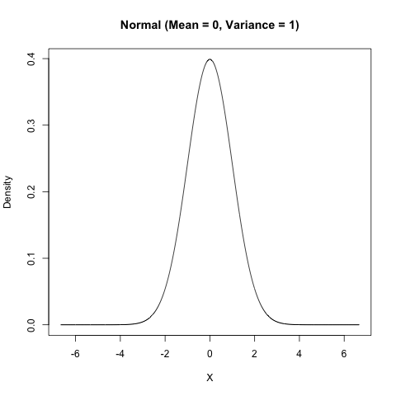
Example: The Normal Distribution
dnorm
"dnorm" is the normal function's probability density function.
Specifies relative likelihood
This defines the "bell curve" shape of the normal distribution.
This is descriptive but not so useful.

Slide 62
Example: The Normal Distribution
Construct the values for the X-axis, using the "seq" function
> Values <- seq(from = -3, to = 3, by = .05)
Construct the cumulative probability curve
for a Normal distribution with mean = 0 and standard deviation = 1
> Density <- pnorm(x, mean = 0, sd = 1)
Plot the results, using:
"Values" as the X-axis and
"Density", the probability density function, as the Y-axis
> plot(x = Values, y = Density)

Slide 63
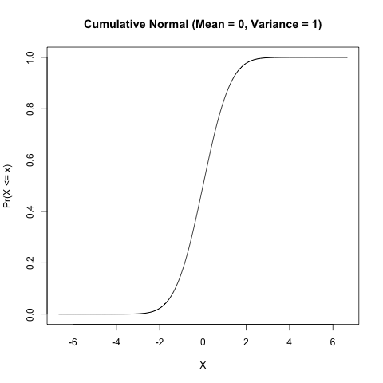
Example: The Normal Distribution
qnorm
"qnorm" is the normal function's cumulative density function.
Specifies probability of a value belonging to a region less-than x
This is useful for considering how reasonable a result is

Slide 64
Once Again: Normal Distribution
"rnorm" generates random samples from a normal distribution
"dnorm" is the density function
"pnorm" is the cumulative distribution function
Corresponding functions are available for most statistical distributions (Student, Binomial, Poisson, etc.)

Slide 65
Questions?

Slide 66
Exercise: Descriptive Statistics
Load the "survey" data set
Using a data set, compute the mean (µ) and standard deviation (σ)
Generate a simulated population (N = 1000) such that Y ~ Normal(µ, σ²)
Plot the original population and and the newly modeled population

Slide 67
Quantile-Quantile Plots
Assess "goodness of fit" graphically
Answers are two data sets similar?
Three Functions:
  qqnorm (produce a Normal QQ-Plot)
  qqline (produce the QQ-Line for reference)
  qqplot (compare two different data samples)

Slide 68
Example: QQ-Plots
Once again, the "survey" data
> library(MASS)
> data(survey)
Draw the normal QQ-Plot of the heights of the students
> qqnorm(survey$Height)
> qqline(survey$Height)

Slide 69
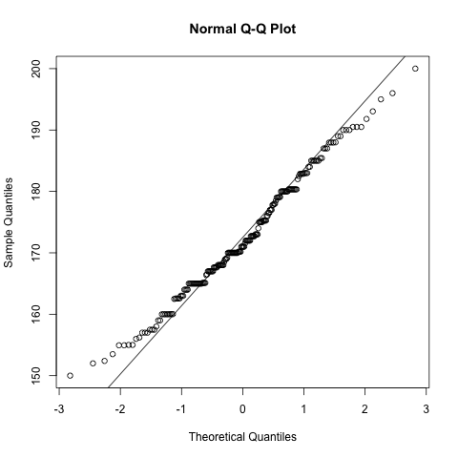
Example: QQ-Plots
qqnorm
"qqnorm" is draws a QQ-plot of the sample data against a normal distribution
The "linear-ness" of the dots describes the data's normality
This can be useful in the absence of numeric tools

Slide 70
Example: QQ-Plots
Let's see an example of two things not being similar
> values.normal <- rnorm(1000, mean=3, sd=1)
> values.gamma <- rgamma(1000, alpha=1, shape=1)
Compare the two using a QQ-plot
> qqplot(values.normal, values.gamma)
> qqline(values.normal)

Slide 71
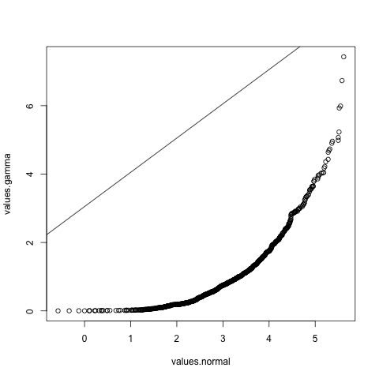
Example: QQ-Plots
qqnorm
"qqplot" is draws a QQ-plot of the sample data against a normal distribution
The "linear-ness" similarity between the two samples
The gamma and normal distribution are not so similar.

Slide 72
Example: QQ-Plots
Let's demonstrate something we already know. The T-distribution becomes normal with large degrees of freedom
> par(mfrow=c(1, 2))
> t.values <- rnorm(n=1000, df=3)
> normal.values <- rnorm(n=1000)
Compare the two using a QQ-plot
> qqplot(t.values, normal.values)
> qqline(t.values)
Then
> t.values <- rt(n=1000, df=30)
> qqplot(t.values, normal.values)
> qqline(t.values)

Slide 73
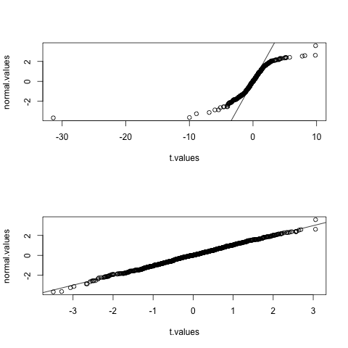
Example: QQ-Plots
qqnorm
The top represents T-distribution with "df=3"
The bottom is "df=30"
"par(mfrow=c(2, 1))" specifies that that plots should be stacked on top of anothert

Slide 74
Example: QQ-Plots
qqnorm
The top represents T-distribution with "df=3"
The bottom is "df=30"
"par(mfrow=c(2, 1))" specifies that that plots should be stacked on top of anothert

Slide 75
Questions?

Slide 76
Inferential Statistics

Slide 77
Inferential Statistics
Not strictly desctiptive
Interpolates and Extrapolates Data
Much more interesting than descriptive stats

Slide 78
Zelig
Incorporates R code from many different researchers
Provides single format for entering code from a variety of sources
Great documentation
http://gking.harvard.edu/zelig

Slide 79
User-designed logistic regression package
User-designed multinomial regression package
User-designed poisson regression package
User-designed MLM package
ZELIG
Consolidates language from various users
Creates a single, uniform language for conducting statistical analyses

Slide 80
Installation: Zelig
Install Zelig
> install.packages("Zelig")
Load the library
> library(Zelig)

Slide 81
Regression Models in Zelig
Zelig offers a wide variety of regression models
  Multinomial, logistic, poisson, continuous dependent variable models
  Mixed models
  Survey data models
  See Zelig manual for a complete list
  S:\DataClass\RandStatistics\Zelig Manual.pdf

Slide 82
Regression Models in Zelig
All models are specified using the same basic format
  Specify your regression model
  Request the regression procedure you’d like to use
  Tell Zelig which dataset to use
> zelig( y ~ x1 + x2, model="ls", data=dataname)

Slide 83
Multiple Regression
Let’s predict bmi based on:
  number of cigarettes smoked/day (cigsday)
  duration of moderate exercise (modmin)
  sleep (sleep)
Call up the National Health Interview Survey
  load("N:\\R and Statistics\\NatHealth2008.Rdata")
  attach(NatHealth2008)

Slide 84
Multiple Regression
Plug our information into the standard Zelig format
  We’ll use the least squares (“ls”) option because bmi is a positive, continuous dependent variable
  weight.out <- zelig(bmi~cigsday+modmin+sleep, model="ls", data=NatHealth2008)
  summary(weight.out)

Slide 85
Multiple Regression
Call:
zelig(formula = bmi ~ cigsday + modmin + sleep, model = "ls",
data = NatHealth2008)
Residuals:
Min 1Q Median 3Q Max
-1295.79 -399.36 -79.89 291.20 3588.20
Coefficients:
Estimate Std. Error t value Pr(>|t|)
(Intercept) 2903.2941 72.1368 40.247 < 2e-16 ***
cigsday -0.5936 1.3984 -0.425 0.67124
modmin -0.3008 0.2019 -1.490 0.13634
sleep -26.5090 9.5673 -2.771 0.00565 **
---
Signif. codes: 0 ‘***’ 0.001 ‘**’ 0.01 ‘*’ 0.05 ‘.’ 0.1 ‘ ’ 1
Residual standard error: 567.6 on 1952 degrees of freedom
Multiple R-squared: 0.005009, Adjusted R-squared: 0.00348
F-statistic: 3.276 on 3 and 1952 DF, p-value: 0.0203

Slide 86
Logistic Regression
Let’s predict the probability of being diagnosed with hypertension based on age, sex, sleep, and bmi
  hyp.out <- zelig (hypev~AGE_P+sex+sleep+bmi, model="logit", data=NatHealth2008)
  summary(hyp.out)

Slide 87
Logistic Regression
Deviance Residuals:
Min 1Q Median 3Q Max
-2.4823 -0.7491 -0.4302 0.8471 2.7953
Coefficients:
Estimate Std. Error z value Pr(>|z|)
(Intercept) -6.763e+00 1.412e-01 -47.908 <2e-16 ***
AGE_P 6.548e-02 1.109e-03 59.031 <2e-16 ***
sex 6.238e-03 3.485e-02 0.179 0.858
sleep -1.711e-02 1.223e-02 -1.399 0.162
bmi 9.863e-04 2.899e-05 34.023 <2e-16 ***
---
Signif. codes: 0 ‘***’ 0.001 ‘**’ 0.01 ‘*’ 0.05 ‘.’ 0.1 ‘ ’ 1
(Dispersion parameter for binomial family taken to be 1)
Null deviance: 25927 on 20717 degrees of freedom
Residual deviance: 20265 on 20713 degrees of freedom
AIC: 20275

Slide 88
Logistic Regression
Zelig also great for generating meaningful interpretations of equations
Let’s look at the probability of hypterension based on age
First, tell Zelig the values of age that we’re interested in testing:
  x.low <- setx(hyp.out, AGE_P=33)
  x.high <- setx(hyp.out, AGE_P=61)

Slide 89
Logistic Regression
Now that we set our values, we can ask Zelig to produce some meaningful statistics based on our criteria
First, save your output as an object – I’m calling mine “s.out”
  s.out <- sim(hyp.out, x=x.low, x1=x.high)
Now, take a look at s.out
  summary(s.out)
  plot(s.out)

Slide 90
Logistic Regression
Values of X
(Intercept) AGE_P sex sleep bmi
1 1 33 0.5549281 7.179747 2763.163
Values of X1
(Intercept) AGE_P sex sleep bmi
1 1 66 0.5549281 7.179747 2763.163
Expected Values: E(Y|X)
mean sd 2.5% 97.5%
1 0.1198186 0.003121433 0.1140429 0.1262853
Predicted Values: Y|X
0 1
1 0.874 0.126
First Differences in Expected Values: E(Y|X1)-E(Y|X)
mean sd 2.5% 97.5%
1 0.4215098 0.006301644 0.4094499 0.4336803
Risk Ratios: P(Y=1|X1)/P(Y=1|X)
mean sd 2.5% 97.5%
1 4.520915 0.1250251 4.273213 4.763982
Expected value of hypertension in a 33 year old (y|x) given current sampling distribution
Predicted values of y|x given Binomial distribution
Difference in expected value of a 66 vs. 33 year old
Relative risk ratio (similar idea to odds ratio, but different calculation)
There is a 3.8 times greater probability of hypertension for a 66 year old vs. a 33 year old
Notes:
http://www.childrens-mercy.org/stats/journal/oddsratio.asp

Slide 91
Questions?

Slide 92
Exercise: Zelig Regression Model
Load "Zelig" and the "turnout" data set
Fit the data using the "logit" model
Plot the fitted model (using the plot function)
Predict voter turnout based on 2 or more explanatory variables
Answer "Would (appropriately educated) 10 year olds show up to the voter polls?"
Plot the results of the simulations

Slide 93
Multiple Imputation
Majority of datasets contain missing data
  Produces a variety of problems and limitations to data analysis
Multiple imputation (MI) generates multiple, complete datasets that contain estimations of missing datapoints

Slide 94
Multiple Imputation
MI typically thought of as involving three steps:
  Selection of imputation model
  Generation of imputed datasets
  Combining results across imputed datasets
We’re focusing on 2 & 3
**Please make sure you have a solid understanding of all steps before performing MI with your own data**

Slide 95
Multiple Imputation
Amelia package in R is powerful, fast, and easy to use
Relies on Expectation maximization baysian (EMB) algorithm (Honaker & King, 2010)
See Amelia documentation for more information about its imputation procedures
S:\DataClass\RandStatistics\Amelia Documentation.pdf

Slide 96
Multiple Imputation
First, we’ll need to install Amelia:
install.packages("Amelia",repos="http://r.iq.harvard.edu")
library(Amelia)

Slide 97
Multiple Imputation
We’re going to create several datasets to look at a model predicting the number of days of work missed/year (wkdayr)
Let’s say we want to predict wkdayr using:
  Cigarettes smoked/day (cigsday)
  Amount of moderate exercise (modmin)
  Sleep (sleep)

Slide 98
Multiple Imputation
Before running Amelia you’ll need a single dataset completely prepped for MI
  Data should be completely cleaned
  Categorical variables should be dummied (with one omitted)*
  Data should contain only variables in your imputation model + any ID variables you’ll need to merge your datasets
*Amelia can dummy your variables for you – but you won’t be able to control your omitted category

Slide 99
Multiple Imputation
Now, load your data – it’s already been prepped for MI
load("N:\\R and Statistics\\NatHealth2008MI.Rdata")
attach(NatHealth2008MI)
Make one final review of your data
Summary(NatHealth2008MI)

Slide 100
Multiple Imputation
Amelia Imputation Options:
  “idvars” – specifies identification variables that you want to keep in your dataset, but are not part of the imputation model
  “noms” tells R which variables are nominal
  “ords” tells R which variables are ordinal
  “ts” used to signify time series variables
  “cs” used to signify cross-sectional variables

Slide 101
Multiple Imputation
Now, let’s create our imputed datasets
NatHealth.MI <- amelia(NatHealth2008MI, m=5, idvars=c("id“))
How many datasets did we create?
What is idvars option doing here?

Slide 102
Multiple Imputation
Now let’s review the results our MI
Compare observed to imputed values
  plot(NatHealth.MI, which.vars=9:12)
  We’re asking for plots of variables 9-12
  Red line = imputed values
  Black line = observed values
  If variable is fully observed, it is plotted in blue

Slide 103
Multiple Imputation
We can also overimpute variables to gauge quality of our imputation
  Treats every OBSERVED value as if it was missing
  Then, impute many values for that observed value and view confidence intervals of these estimates
  Examine whether confidence intervals overlap the “true” value on the x=y line
  Circles represent the mean imputed value
  overimpute(NatHealth.MI, var="beddayr")

Slide 104
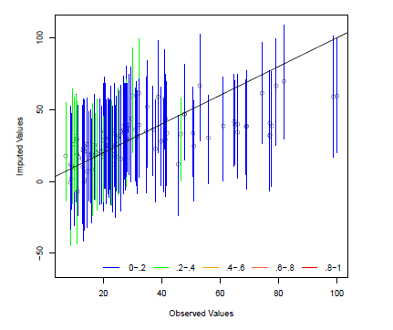
Multiple Imputation

Slide 105
Multiple Imputation
Saving imputed data as one dataset
  save(NatHealth.MI, file=" S:\\DataClass\\RandStatistics \\NatHealthImputed.Rdata")
Save datasets separately
  write.amelia(obj=NatHealth.MI, file.stem=" S:\\DataClass\\RandStatistics \\NatHealthImputed")

Slide 106
Multiple Imputation
Combining MI results
  miWKDAYR <- zelig(wkdayr~cigsday+modmin+sleep, model="ls",
  data = mi(NatHealthImputed1, NatHealthImputed2,
  NatHealthImputed3, NatHealthImputed4, NatHealthImputed5))
  summary(miWKDAYR)

Slide 107
Combining MI Results
zelig(formula = wkdayr ~ cigsday + modmin + sleep, model = "ls",
data = mi(NatHealthImputed1, NatHealthImputed2, NatHealthImputed3,
NatHealthImputed4, NatHealthImputed5))
Coefficients:
Value Std. Error t-stat p-value
(Intercept) -10.967779007 7.79393642 -1.40721946 0.1888879
cigsday 0.005148175 0.15353988 0.03352989 0.9732959
modmin -0.034469722 0.02450667 -1.40654426 0.1597445
sleep 2.509761238 1.15469415 2.17352902 0.0602578
For combined results from datasets i to j, use summary(x, subset = i:j).
For separate results, use print(summary(x), subset = i:j).

Slide 108
Questions?

Slide 109
Exercise 2: Multiple Imputation

Slide 110
Thanks!
More questions? Email:
mowen@iq.harvard.edu
More Information about R:
http://cran.r-project.org/
For more information about R and Zelig:
http://gking.harvard.edu/zelig/
More lecture series are available!
R Developers course starting this Winter

